Slide 1

FINMARK CORPORATION | TERMINAL ASSESSMENT
FinMark
Turning Customer Data Into Business Insights
From data challenges to a proposed machine learning solution.
MO-IT162 | SECTION A3101 | TEAM 3
MO-IT162 | SECTION A3101 | TEAM 3
01 / 09
01 / 09
Notes:
Good day, everyone. We are Group 3, and today we will present our analysis titled "Turning Customer Data Into Business Insights" for FinMark Corporation.
Our study focuses on two business concerns: understanding market trends and understanding customer behavior. We examined FinMark's available records to identify meaningful patterns and determine what those findings could contribute to business decisions.
We will discuss our data, how we prepared it, our main findings, and two possible machine learning solutions for future development.

Slide 2
01 DATA COLLECTION
Three sources, three different groups of customers
CUSTOMER PROFILES
PURCHASE RECORDS
SOCIAL MEDIA RECORDS
2,378
2,420
2,411
customers, one row each
purchase rows from 1,642 buyers
interaction events from 1,640 customers
TIME WINDOW
Purchases: Jul 2022 to Jun 2024
Social: Jul 2023 to Jun 2024
Shared 12 months (Jul 2023 to Jun 2024)
Profile signup dates: 2019 to 2024; earlier dates extend outside the chart.
718 all three sources, full dates
1,306 profiles + purchases, all dates
564 purchases + social, shared year
457 all three sources, shared year
FINMARK | TEAM 3 | MO-IT162
Cleaned FinMark CSVs | customer counts unless marked
02 / 09
02 / 09
Notes:
We used three datasets: customer profiles, purchase transactions, and social media interactions.
After cleaning, these contained 2,378 customer profiles, 2,420 purchase records, and 2,411 social media interactions.
However, the files cover different periods and do not always include the same customers. We identified 1,306 customers with both profiles and purchases. For purchases and social media during the same year, there were 564 matching customers. Only 457 had records across all three sources during that year.
This is important because each comparison must use the customers and time period relevant to that question. Before making those comparisons, we checked the quality of the records.

Slide 3
02 DATA QUALITY
Cleaning fixed what it could; three issues stay open
1 Preserve
2 Inspect
3 Treat
4 Recheck
54
336
420
zero-amount purchases
transaction IDs not in profiles
purchases dated before signup
kept; meaning not confirmed
social side: 336 too; 184 on both lists
within 309 of 1,306 matched customers
Raw files: 3,200 rows each. Cleaned: 2,378 profiles, 2,420 purchases, 2,411 social events. No blank cells or repeated rows remain. Some business facts remain uncertain.
FINMARK | TEAM 3 | MO-IT162
Raw + cleaned CSVs | independent verification
03 / 09
Notes:
Before our analysis, we checked the records for missing information, duplicates, and inconsistencies.
We kept the original datasets, corrected only issues we could verify, and checked the cleaned results again. Even after cleaning, we identified some concerns.
For example, 54 purchases had a recorded amount of zero. Both the purchase and social media files contained 336 customer IDs that did not match the profiles. We also identified 420 purchases dated before the recorded signup date.
Rather than guessing what these records meant, we documented them as limitations. This helped us avoid conclusions the data could not support. With these limitations identified, we moved to the analysis.

Slide 4
03 EXPLORATORY ANALYSIS
Each question counted at its own unit
MONTH
PURCHASE
When were more purchases recorded?
Which products were purchased most?
24 monthly counts
5 product categories
CUSTOMER
CUSTOMER
Did customer groups buy different products?
Do social posts track spending?
one count per person
same-year customers only
Many posts or purchases can still come from one person.
FINMARK | TEAM 3 | MO-IT162
FinMark cleaned files and project analysis
04 / 09
Notes:
After preparing the data, we organized our analysis around FinMark's business questions.
We examined when purchases occurred, which products were purchased, how customers differed in their buying activity, and whether demographic characteristics or social media activity were related to purchases.
One important consideration was the difference between transactions and customers. A person may buy several times, but still represents only one customer when comparing customer groups.
With this approach, we first examined overall market activity before moving to individual purchasing behavior.

Slide 5
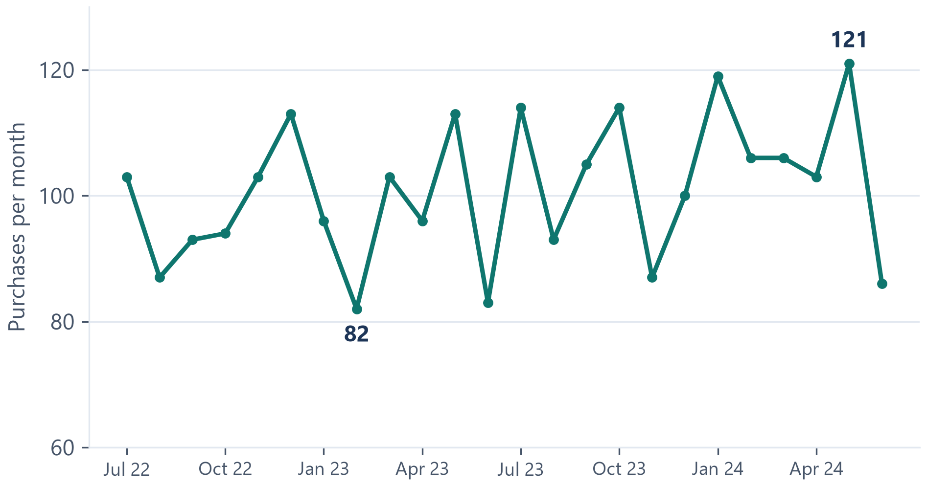
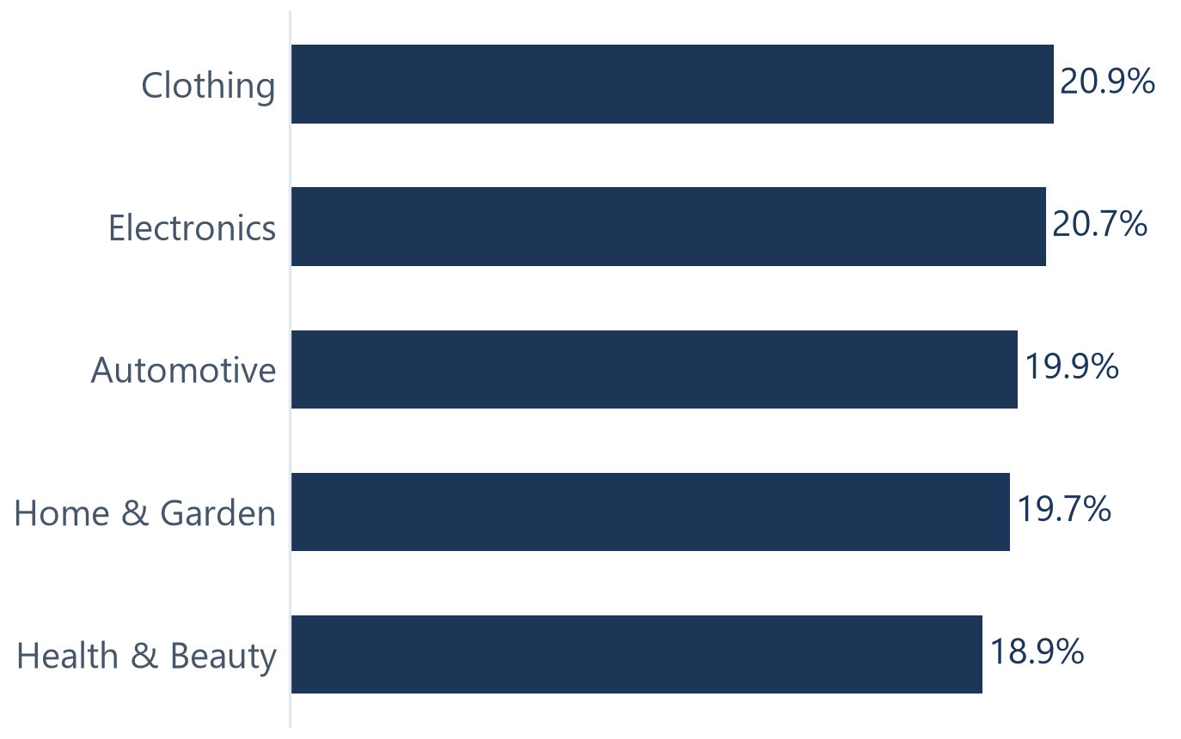
04 MARKET TRENDS
Purchases ranged 82 to 121 a month; categories stayed close
Purchases per month, Jul 2022 to Jun 2024 (n = 2,420 rows)
Category share of all 2,420 purchases
Recorded counts, not profit. Two years is too short to show a seasonal pattern.
Recorded counts, not profit. Two years is too short to show a seasonal pattern.
FINMARK | TEAM 3 | MO-IT162
2,420 cleaned transactions | recomputed
05 / 09
05 / 09
Notes:
Our first finding concerns purchasing activity over time.
From July 2022 to June 2024, monthly purchases ranged from 82 to 121. Although the numbers changed, two years of records are not enough to confirm a recurring seasonal pattern or explain the causes.
We also examined the five product categories. Their shares were close to one another, with each accounting for roughly one-fifth of purchases. No category clearly dominated.
For FinMark, this supports monitoring overall activity and category performance rather than assuming one category will always lead. We then looked beyond total purchases to understand individual buyers.

Slide 6
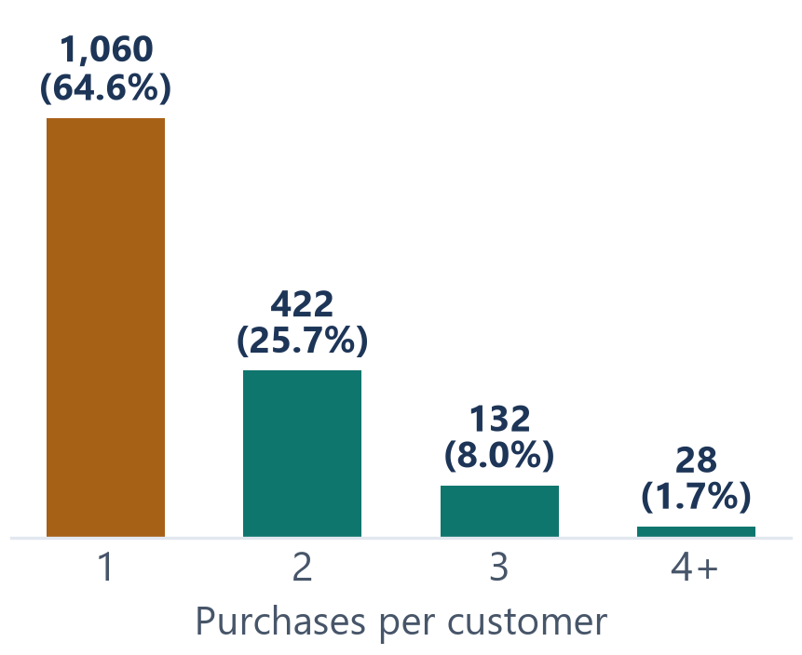
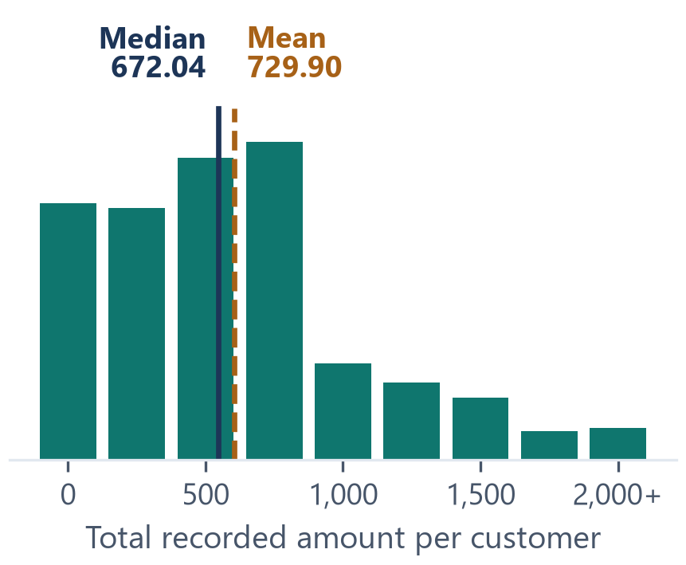
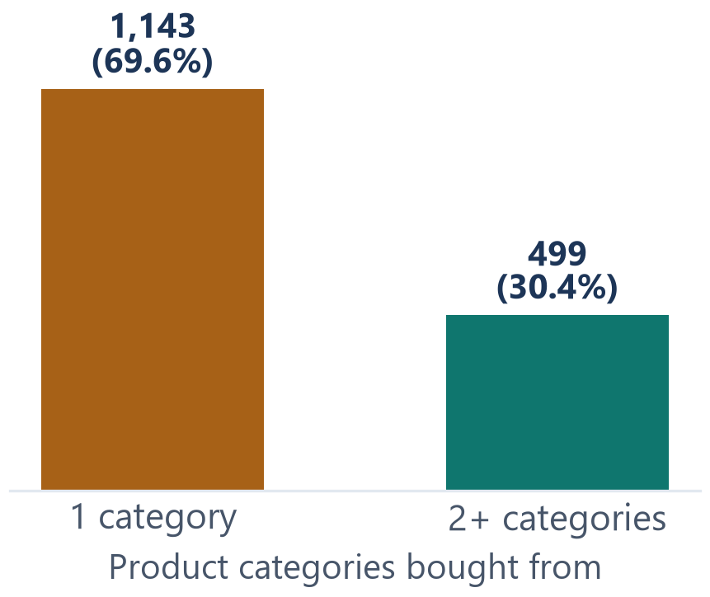
05 PURCHASING HABITS
Most buyers bought once, and most stayed in one category
1,642 purchasing customers, Jul 2022 to Jun 2024. Recorded purchases, not lifetime habits.
64.6%
672.04 | 729.90
69.6%
bought exactly once (1,060 of 1,642)
bought exactly once (1,060 of 1,642)
median | mean total recorded amount per buyer
bought from one category (1,143)
These differences make customer grouping worth investigating. They do not prove clusters exist.
These differences make customer grouping worth investigating. They do not prove clusters exist.
FINMARK | TEAM 3 | MO-IT162
FINMARK | TEAM 3 | MO-IT162
2,420 cleaned transactions | customer-level recomputation
2,420 cleaned transactions | customer-level recomputation
06 / 09
06 / 09
Notes:
We examined the recorded buying habits of 1,642 customers.
We found that 64.6 percent purchased only once during the two-year period. Customers also differed in total recorded spending. The middle amount was about 672 per buyer, while the average was about 730. These amounts have no confirmed currency designation.
In addition, 69.6 percent purchased from only one product category.
These results describe the customers' recorded activity, not their lifetime habits.
They suggest that grouping customers by purchase frequency, spending, and category choices may be worth investigating. However, they do not prove that meaningful customer groups already exist. We also checked whether other customer information was related to buying.

Slide 7
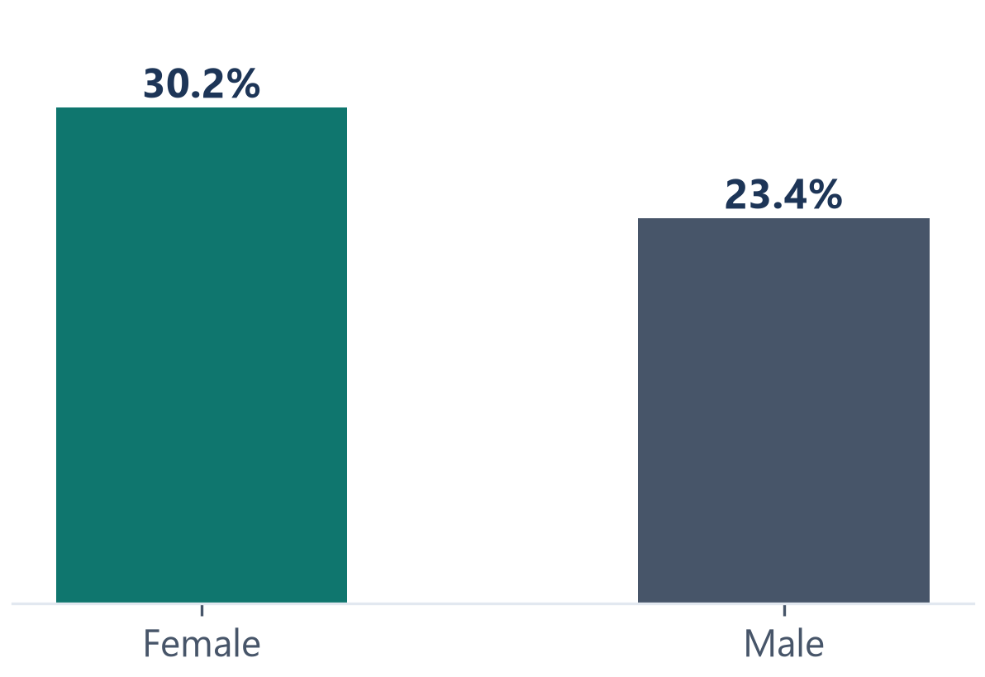
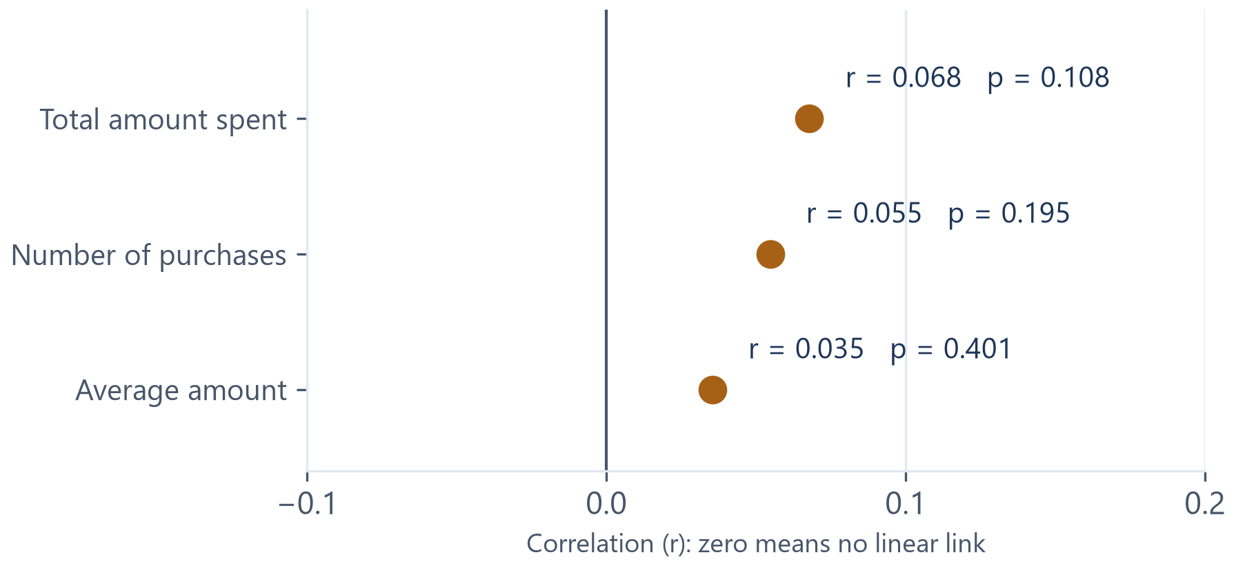
06 CUSTOMER BEHAVIOR
Small differences, and no strong spending link
HOME & GARDEN BY RECORDED GENDER
SOCIAL ACTIVITY VS. SPENDING
Small difference
No strong spending link
Home & Garden: 1,306 customers with profiles and purchases, all dates. Adjusted p = 0.0361; Cramér's V = 0.0743 (very small). Exploratory, not a targeting rule.
Social: 564 customers, Jul 2023 to Jun 2024. Pearson r: total amount 0.068 (p = 0.108); purchases 0.055 (p = 0.195); average amount 0.035 (p = 0.401). Very weak; not statistically significant.
FINMARK | TEAM 3 | MO-IT162
FinMark customer records and calculations
07 / 09
Notes:
We also examined whether demographic information and social media activity were related to purchasing.
For Home and Garden, about 30 percent of women and 23 percent of men in the eligible group had made a purchase. Our checks identified a difference, but its overall strength was small. This is not enough to recommend targeting customers based on gender alone.
We also compared social activity and spending among 564 customers during the same year. We found no strong relationship between the two.
These findings suggest that actual buying patterns deserve more attention than assumptions based only on personal characteristics or online activity. We then considered what FinMark could do with these results.

Slide 8
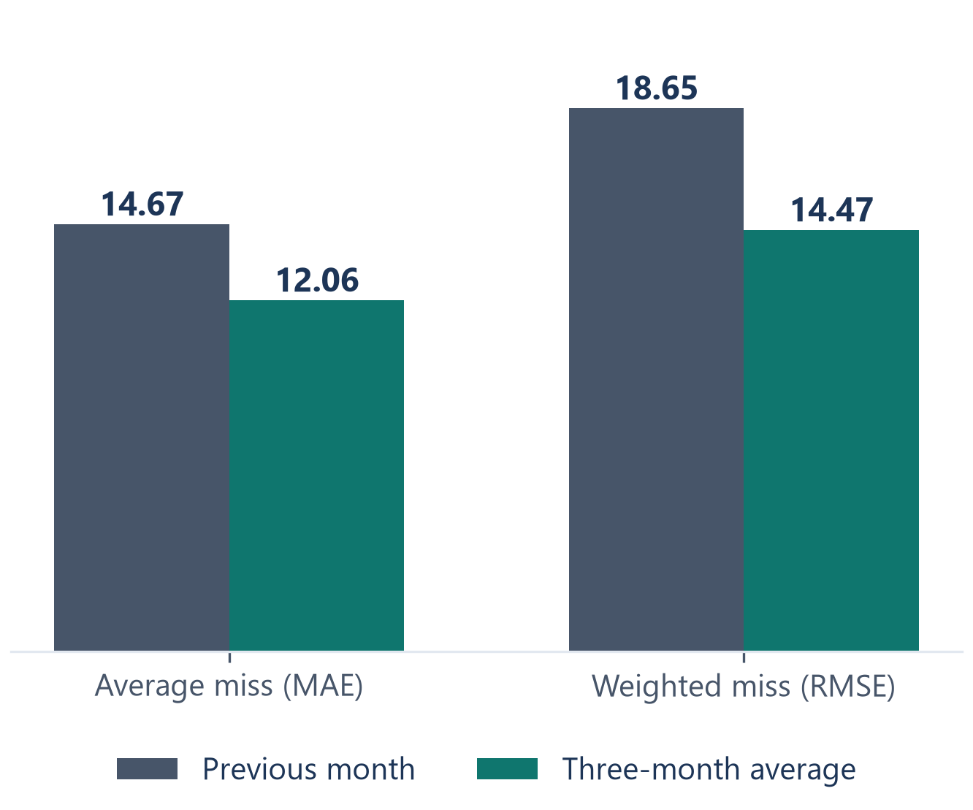
07 WHAT COMES NEXT
The three-month average missed less, but still missed
WHAT FINMARK CAN DO NOW
Jan to Jun 2024 holdout: lower error is better
01
Track purchases over time
02
Study what customers actually buy
03
Improve the customer records
Simple baselines, not trained ML models
MAE: average miss. RMSE: weights large misses more. Six monthly observations; not a production forecast.
FINMARK | TEAM 3 | MO-IT162
Cleaned purchases | our additional estimate test
08 / 09
Notes:
Based on our findings, FinMark can already take several practical steps without immediately developing a machine learning system.
First, the company can monitor monthly purchases and the total amounts recorded.
Second, it can examine customer purchasing habits and compare product categories before making marketing or inventory decisions.
Third, FinMark needs to improve the reliability of its records, particularly the transactions with zero amounts and the customer information that does not match.
These recommendations are consistent with what we established in Milestone 2.
We also tested two simple ways of estimating monthly purchases. The three-month average performed better in our limited test, but it still produced errors.
These findings provide a starting point for the next stage of our project.

Slide 9
08 WHAT COMES NEXT
Two conditional next steps; neither is validated yet
MARKET TRENDS
CUSTOMER BEHAVIOR
Time-Series Forecasting
K-Means Customer Clustering
Comparison option: Agglomerative clustering
WHY
WHY
Monthly counts ranged 82 to 121; the 3-month average missed by 12.06 (MAE).
Age and social posts show no strong link to spend; 64.6% bought once.
ADVANTAGE
ADVANTAGE
Uses all 2,420 purchase rows, with no joins.
No predefined target; groups customers on purchase patterns.
LIMIT
LIMIT
24 months is too short to prove multi-year seasonality.
Short histories; matched customers only (1,306 or 457).
FIRST STEP
FIRST STEP
Collect newer monthly records; test against the 12.06 MAE baseline.
Scale features on a matched cohort; validate with Silhouette and Davies-Bouldin.
Both are proposals. Neither has been built, trained, or validated.
EDA gives trustworthy insight now. Forecasting and clustering need validation first.
FINMARK | TEAM 3 | MO-IT162
FinMark findings | supplemental monthly estimate checks
09 / 09
Notes:
Building on our earlier analysis, we identified two possible machine learning approaches that FinMark could investigate in the future.
The first is Time-Series Forecasting. This follows from our findings on monthly purchasing activity and the simple forecasting methods we evaluated in Milestone 2. A future model could be tested to determine whether it produces more accurate estimates.
The second is K-Means Clustering. We considered this after extending our analysis to individual purchasing habits. We found differences in how frequently customers purchase, how much they spend, and which categories they choose. K-Means could help us investigate whether these patterns form useful customer groups.
However, neither approach has been trained or validated. We are recommending further investigation, not immediate implementation.
To conclude, our project progressed from understanding the available data, to identifying useful patterns, and finally to exploring how those findings could support future machine learning solutions.
Our main takeaway is that reliable data and meaningful analysis must come first before FinMark can confidently use machine learning to support business decisions.
That concludes our presentation. Thank you!

